Slide 1
Agenda 9/15
Questions?
Project 1 Update
Pixels and Inches
How to Save your canvas for Printing
Functions for creating motifs
In-class Exercise #4 (Due 9/15)

Slide 2
Project 1 Timeline Update
Post your 3 Patterns & Link to Code
Large Screenshots
Due: W 9/29 (Before Class)
Updated Schedule
W 9/15 – Functions
In-class Exercise #4
M 9/20 – Studio Time* (NO MEETING)
In-class Exercise #5
W 9/22 – Studio Time (NO MEETING)
M 9/27 – Studio Time (In person)
* - I will be available online over MS Teams/Zoom

Slide 3
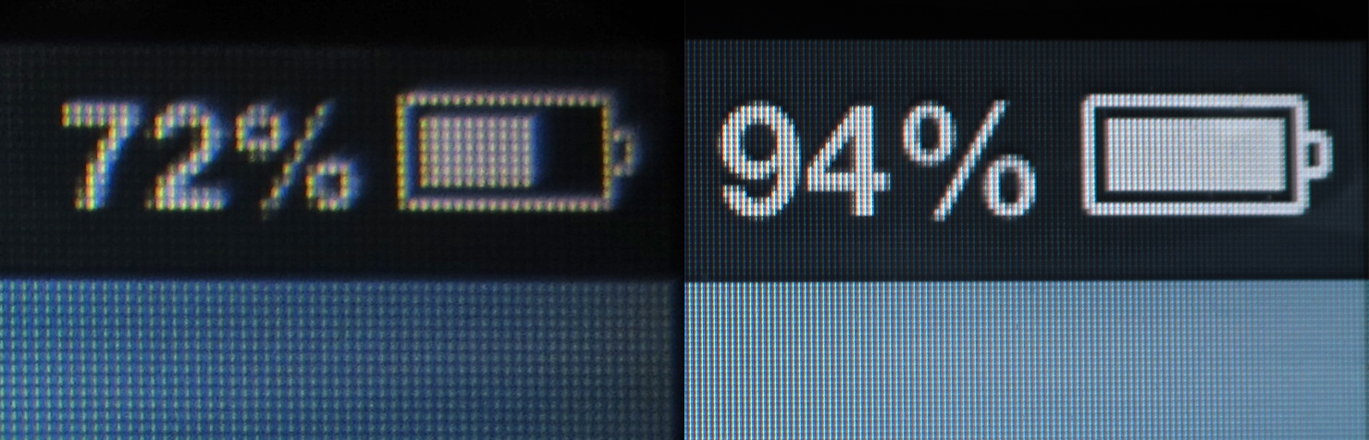
Pixels & Inches
pixels = inches * PPI
PPI (DPI)= pixels/dots per inch
High Resolution Image ~ 300 PPI

Slide 4
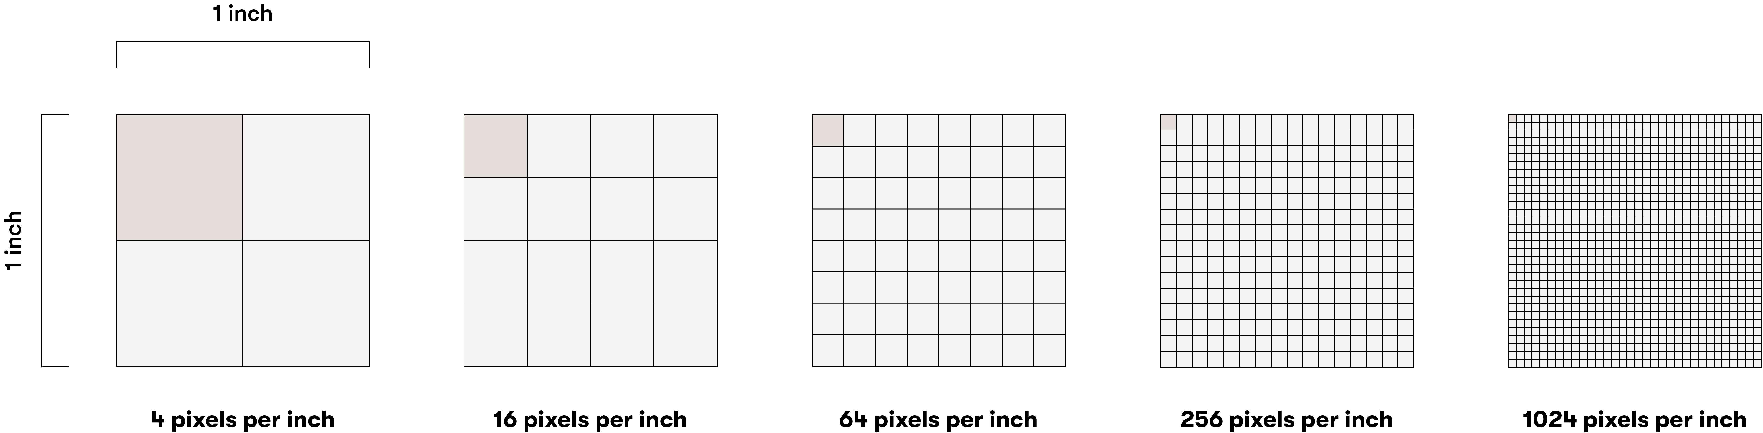
Pixels & Inches
pixels = inches * PPI
PPI (DPI)= pixels/dots per inch

Slide 5
Saving to File
Add this function to the end of your code:
function keyPressed() {
save(‘myPattern.png’) -> You can change this filename
}
Every time you press a key while on your canvas, your browser will save the file as an PNG image

Slide 6
Pixels & Inches
By default, when saving images from p5.js is DPI = 72
To get a 17 X 24 inch printout, what will be your canvas size?
OR
What will be the parameters for createCanvas(X,Y) ?
pixels = inches * PPI
Helpful calculator: https://www.omnicalculator.com/conversion/pixels-to-inches

Slide 7
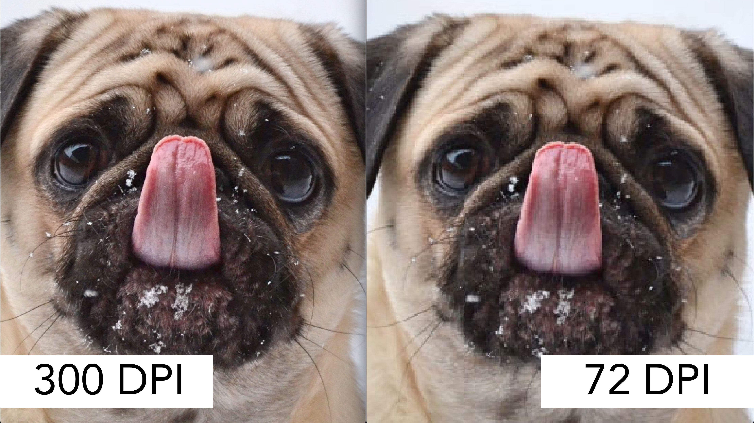
Pixels & Inches
pixels = inches * PPI
PPI (DPI)= pixels/dots per inch
High Resolution Image ~ 300 PPI
What will be your canvas size for Project 1?
The issue with 72 DPI

Slide 8
How to get a High Res image ?
pixelDensity(VAL)
This function will enable you to add more pixels to your sketches
By default, this is set to ~ 1
pixelDensity(2) Will double the number of pixels (144 DPI)
pixelDensity(3) Will triple the number of pixels (216 DPI)
Remember p5.js will only save images in 72 DPI

Slide 9
Screen vs Saving/Printing
Remember p5.js will always save in 72 DPI
pixelDensity(2) Will double the number of pixels (144 DPI), on the screen. But when saving it will double the size. The output image will still have 72 DPI
pixelDensity(3) Will triple the number of pixels (216 DPI), on the screen. But when saving it will triple the size. The output image will still have 72 DPI

Slide 10
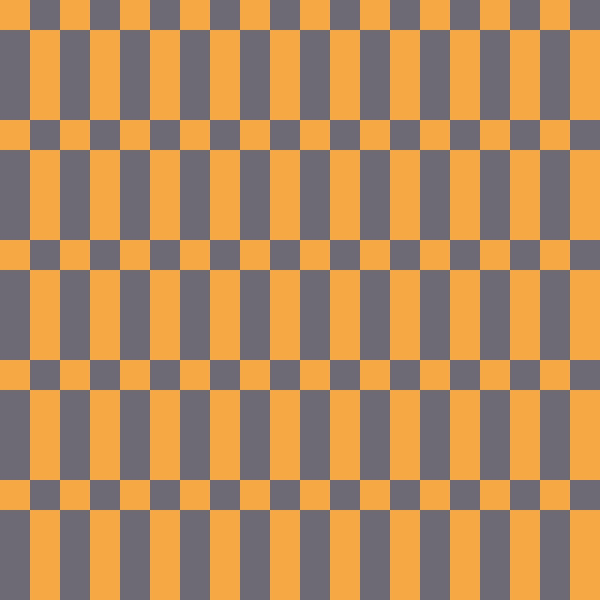
pixelDensity(1)
Screen DPI 72
Screen Size 1200,1700
Print DPI 72
Print Size 17 X 24 inches
pixelDensity(2)
Screen DPI 144
Screen Size 1200,1700
Print DPI 72
Print Size 34 X 48 inches
pixelDensity(3)
Screen DPI 216
Screen Size 1200,1700
Print DPI 72
Print Size 51 X 72 inches

Slide 11
Scale down the larges image to 17 X 24 inches to increase the resolution
pixelDensity(2)
Screen DPI 144
Screen Size 1200,1700
Print DPI 72
Print Size 34 X 48 inches
Scale Down by 2
Print DPI 144
Print Size 17 X 24 inches
pixelDensity(1)
Screen DPI 72
Screen Size 1200,1700
Print DPI 72
Print Size 17 X 24 inches
pixelDensity(3)
Screen DPI 216
Screen Size 1200,1700
Print DPI 72
Print Size 51 X 72 inches
Scale Down by 3
Print DPI 216
Print Size 12 X 24 inches

Slide 12
Steps to Print
Set pixelDensity(1) : This will set the canvas to 72 DPI
Determine the pixels for the canvas:
For E.g. 17 X 24 in = createCanvas(1200,1700)
Complete your drawing
When ready to save/print, set pixelDensity(3)
Save your file to PNG
NOTE: Your file will be 3 times the original size
Scale the Image down to 17 X 22 either in Photoshop or online tool (https://convert-dpi.com/)
Work with Alex/VLR Lab to print your pattern

Slide 13
P5.js functions
We have been using functions all this while….
draw(), circle(), rect()
These are commands to tell the computer to take specific pre-defined actions.
In p5.sj we can create our functions to help us organize our code into smaller chunks and treat complicated tasks as a single step.

Slide 14
P5.js functions
This is the name of your function, and you can call it anything
function myFunction(){
//Do Something
}
function myFunction(x,y){
//Do Something
}
You can create functions that take it parameters
Learn More: https://happycoding.io/tutorials/p5js/creating-functions

Slide 15
P5.js functions
Let’s make a function that will create….
…a red square with a circle
Answer: https://editor.p5js.org/scotchANDsolder/collections/mAmAcn6Su
NOTE: I will be saving in class code examples. You can access them using the link above. I have also put this on the homepage of the class website for easy access/

Slide 16
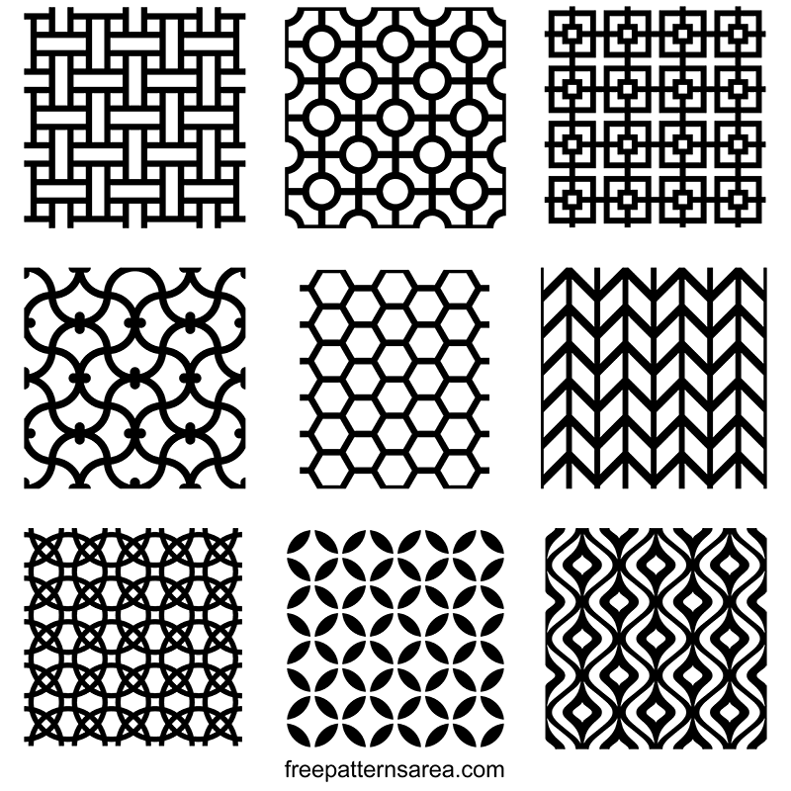
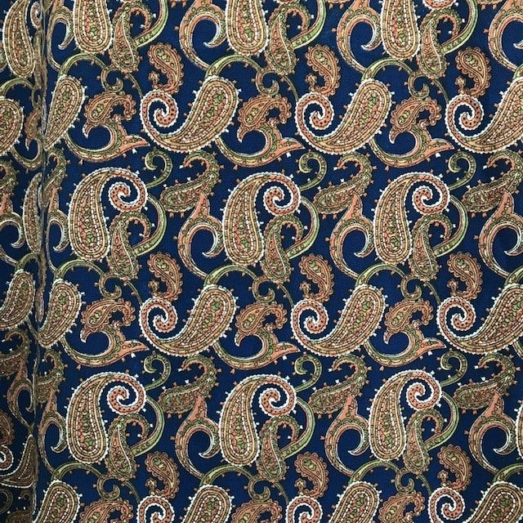
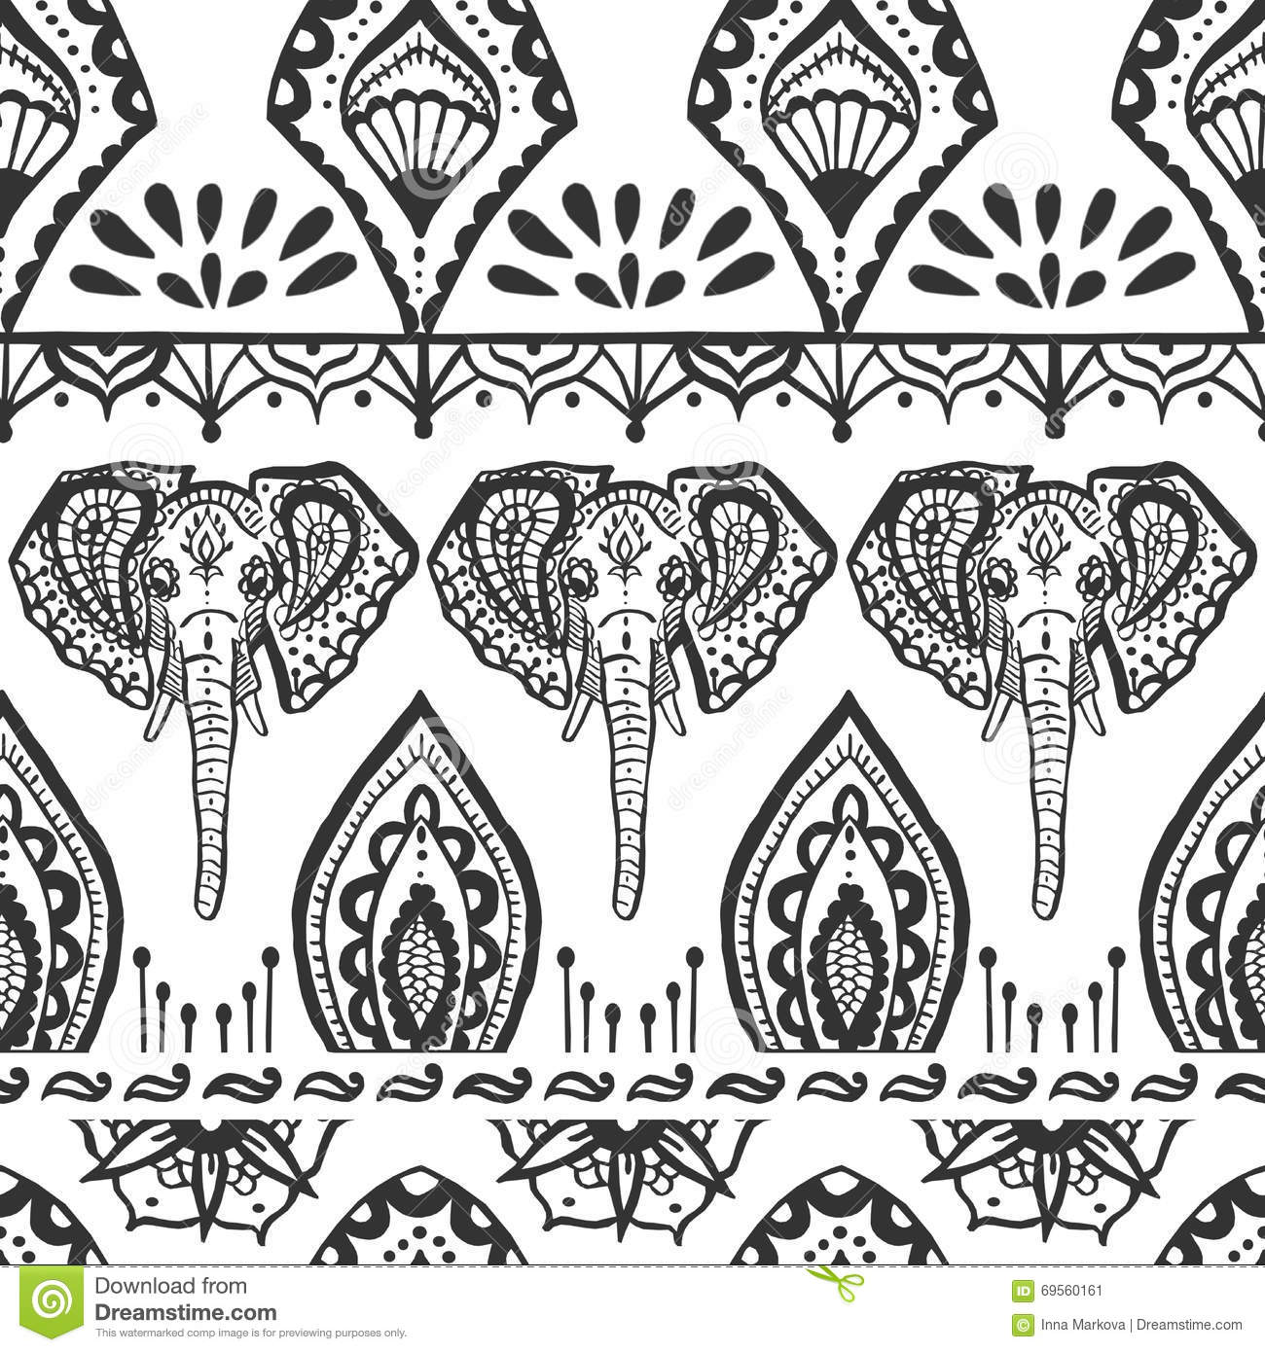
Pattern Forms
Motif: The starting point of any pattern is the single element that will be repeated. Use functions for this!
Tessellation: Process of tiling of a flat surface using or more geometric shapes (motifs)

Slide 17
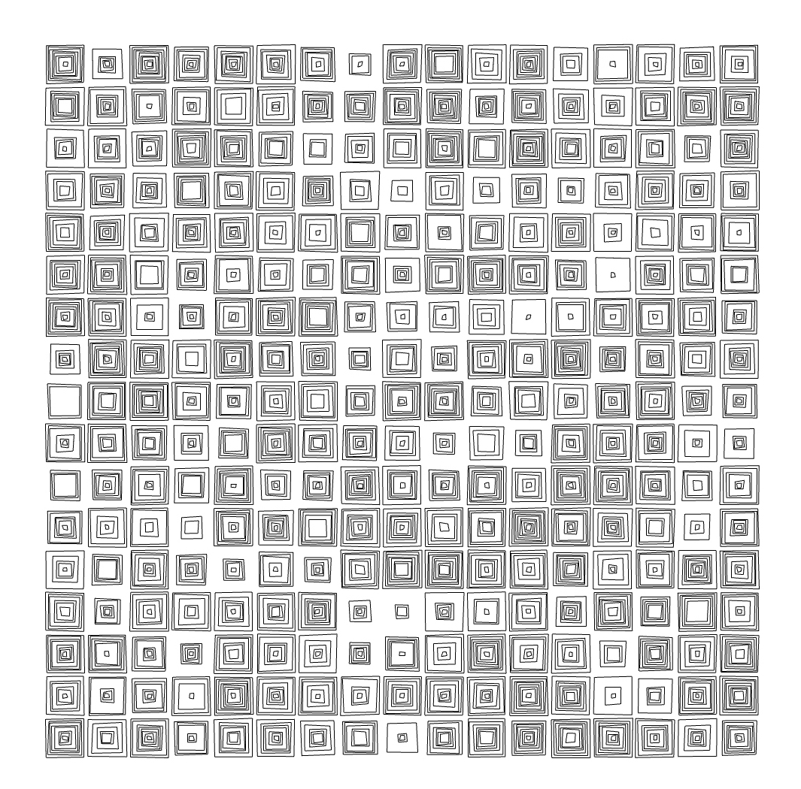
P5.js functions
What is the motif here?
Let’s recreate this Vera Molnar drawing using functions

Slide 18
Notes & Tips
Randomness Spectrum
At one is complete chaos and the other end is complete structure. Find a balance!
Use functions to create motifs
Use nested loops to tile your pattern
Start with the motifs first, sometimes doing it all at the same time can be challenging.
Draw on Paper!
Do not forget Colors &Transparency

